Slide 1
Return on Education Investment in Tennessee
Sarah Pham, Evan Kramer and Desiree Robertson

Slide 2
INTRODUCTION
Funding for the state’s Basic Education Program (BEP) - $175 million investment
Ongoing lawsuit between the State of Tennessee and the two largest school districts (Metro and Shelby County). Underfunding urban school systems
Bill to create a Tennessee Public Charter Commission
Governor Lee’s education savings account program

Slide 3
Intro continued
This education-focused agenda inspired us to tackle assumptions on how certain criteria affect children’s education performance. Specifically, this paper will explore how factors such as per-pupil expenditures, student demographics, and crime rates affect student proficiency and academic improvement.

Slide 4
Research Questions
This study aims to answer the following research questions:
What is the relationship between per-pupil funding and students’ test scores on state standardized tests (TCAP) in Tennessee?
How does per-pupil funding relate to improvements in performance on TCAP?
What is the relationship between student demographics and district size and TCAP results?
How do student demographics relate to improvements in performance on TCAP?
To what degree are county-level factors (e.g., crime rates, housing prices, higher education attainment levels) related to TCAP performance and improvement in TCAP performance ?

Slide 5
outcome variables
Tennessee Comprehensive Assessment Program (TCAP) – standardized testing program used in public schools in Tennessee.
Tennessee Value-Added Assessment System or TVAAS - statistical measure that compares the average predicted scale scores of students in a given district to their actual scale scores.

Slide 6
Predictor Variables
Average daily membership
Number of schools in the district
Amount of per-pupil funding
Proportion of students in the district identified as economically disadvantaged
Proportion of students in the district identified as having a disability
Proportion of county residents with a bachelor’s degree
Crime rate per 1000 residents
Median home sale price

Slide 7
Hypothesis
Assumption is that an increase in per-pupil funding would increase TCAP/TVAAS, negative county-level factors like high crime rates would be correlated with lower TCAP/TVAAS, while higher county-level factors like higher median home prices and higher education attainment levels would correspond to lower TCAP/TVAAS.

Slide 8
Data and Methods
District-level data on test scores, value-added performance, school and district size, student demographics, and per-pupil funding.
County-level crime rate information from Tennessee Bureau of Investigation. Median home sales prices and numbers of homes sold from county-level data collected from the Tennessee Housing Development

Slide 9
Methods
Ordinary least squares regressions
Fixed-effects models that account for unobserved variation between districts.
The results differ slightly between models.

Slide 10
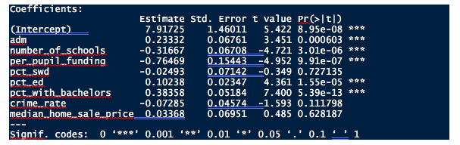
Model 1: OLS with TCAP Proficiency Rates
County-level funding and demographics on TCAP performance
proficiency_rate = β₀ + β₁adm + β₂number_of_schools + β₃per_pupil_funding + β₄pct_swd + β₅pct_ed + β₆pct_with_bachelors + β₇crime_rate + β₈median_home_sale_price + ε

Slide 11
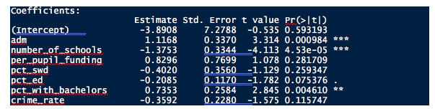
Model 2: OLS with TVAAS Composites
Used same predictor variables
Academic growth than was expected based on their prior testing histories.
Value-added estimates are uncorrelated with student poverty.
Significant but some of the coefficient estimates are no longer significant (e.g., per-pupil funding and percent of economically disadvantaged students

Slide 12
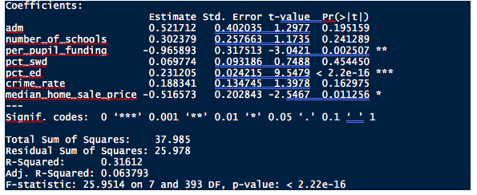
Model 3: Fixed-Effects Model with TCAP Proficiency Rates
Fixed-effects models to account for any between-district variation not adequately captured in OLS models.
Significant effects of per-pupil funding and the percent of students economically disadvantaged

Slide 13
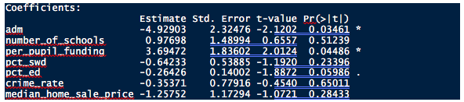
Model 4: Fixed-Effects Model with TVAAS Composites
Very little of the variation.
Increases in per-pupil funding are associated with higher levels of academic improvement

Slide 14

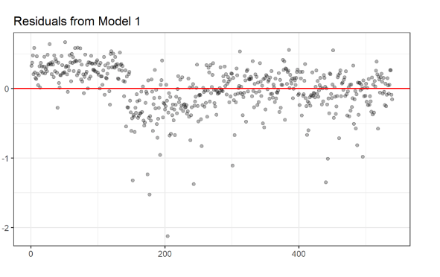
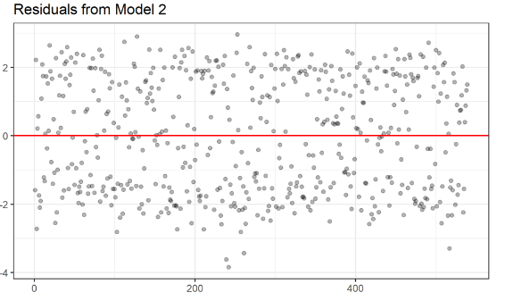
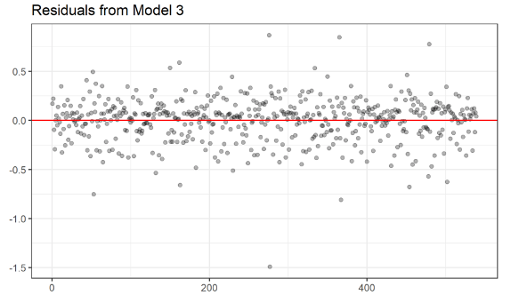
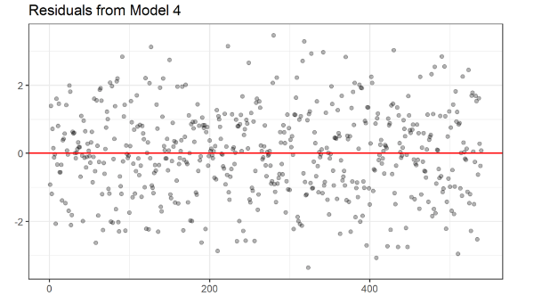
Model Specification Tests
Plotted the residuals of each model to confirm that the residuals are evenly distributed around a mean of 0.

Slide 15
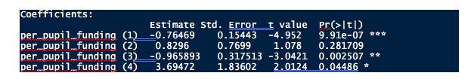
Relationship between Per-Pupil Funding and Academic Performance
Under models 1 and 3, a 10% decrease in per-pupil funding would be associated with a decrease in proficiency rates of between 7.6 and 9.6 percent.
Flipped in the fixed-effects model 4, 10% decrease in per-pupil expenditures then 37% increase in proficiency rates.

Slide 16
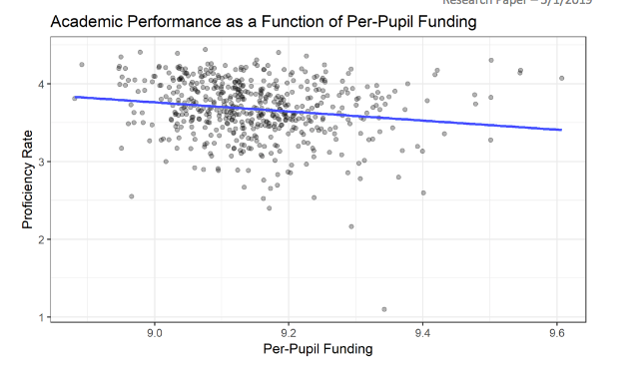

Slide 17
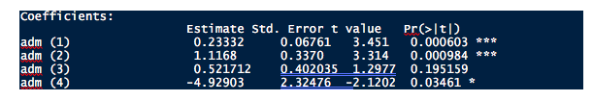
Student Demographics, District Size, and Academic Performance
1st and 2nd models - 10% increase in district average daily membership corresponds to between 2% and 11% increase in academic performance
4th model -10 % increase in average daily membership caused 49% decrease in proficiency rates

Slide 18
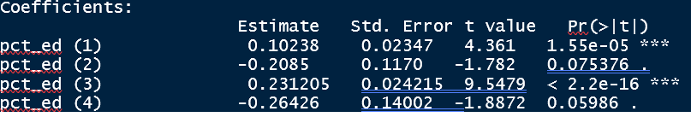
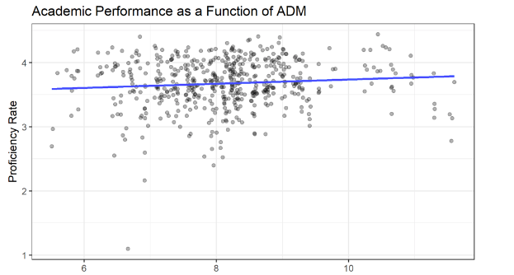
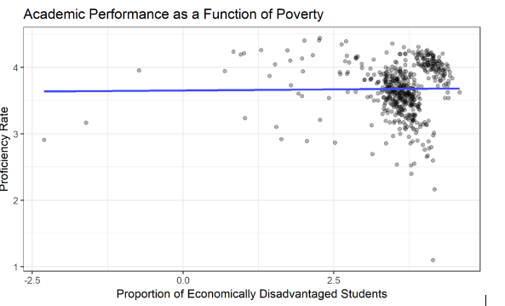
Students in poverty has different effects on proficiency rates and academic improvement in the different models we used.

Slide 19
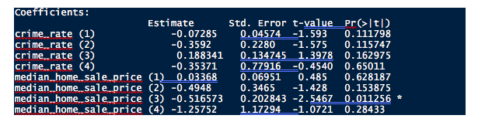
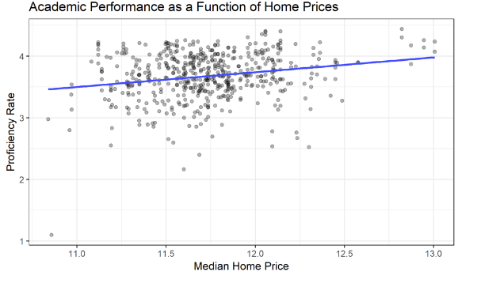
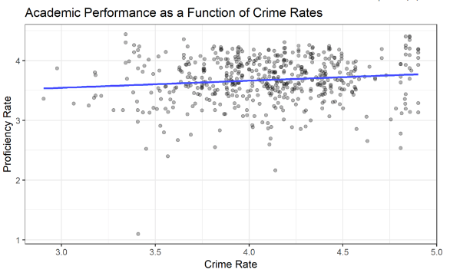
County-Level Factors
Interestingly, across all four models, county-level factors such as crime rates and median home prices appeared not to have a significant influence either on proficiency rates or academic improvement.
Only fixed-effects model in which proficiency rates served as the outcome variable resulted in a significant coefficient.

Slide 20

Conclusions and Limitations
Spend money on poverty reduction rather than crime reduction
More study needed to determine impact of average daily membership and per-pupil funding
Advocate for recalculation of the BEP formula

